Slide 1









INB
BANKING
Guided by:
Sanjit Jha
Developed By:
Noor Ahamed Shaik Richard J
Srimathy L
Diya MONDAL

Slide 2

CONTENTS
Introduction
Tools & Technology UML Diagram Flow Diagram
INB Portal Overview Registration & Login Form Conclusion Acknowledgement

Slide 3

Introduction
User-Friendly Interface: Ensures easy navigation and a seamless online banking experience.
Secure Transactions: Provides robust security features to protect user data and transactions.
Account Management: Allows users to efficiently manage their accounts, view balances, and monitor transactions. Real-Time Notifications: Sends instant alerts for transactions, ensuring users stay informed.
24/7 Accessibility: Offers continuous access to banking services from anywhere at any time.

Slide 4




TOOLS &TECHNOLOGY

Slide 5
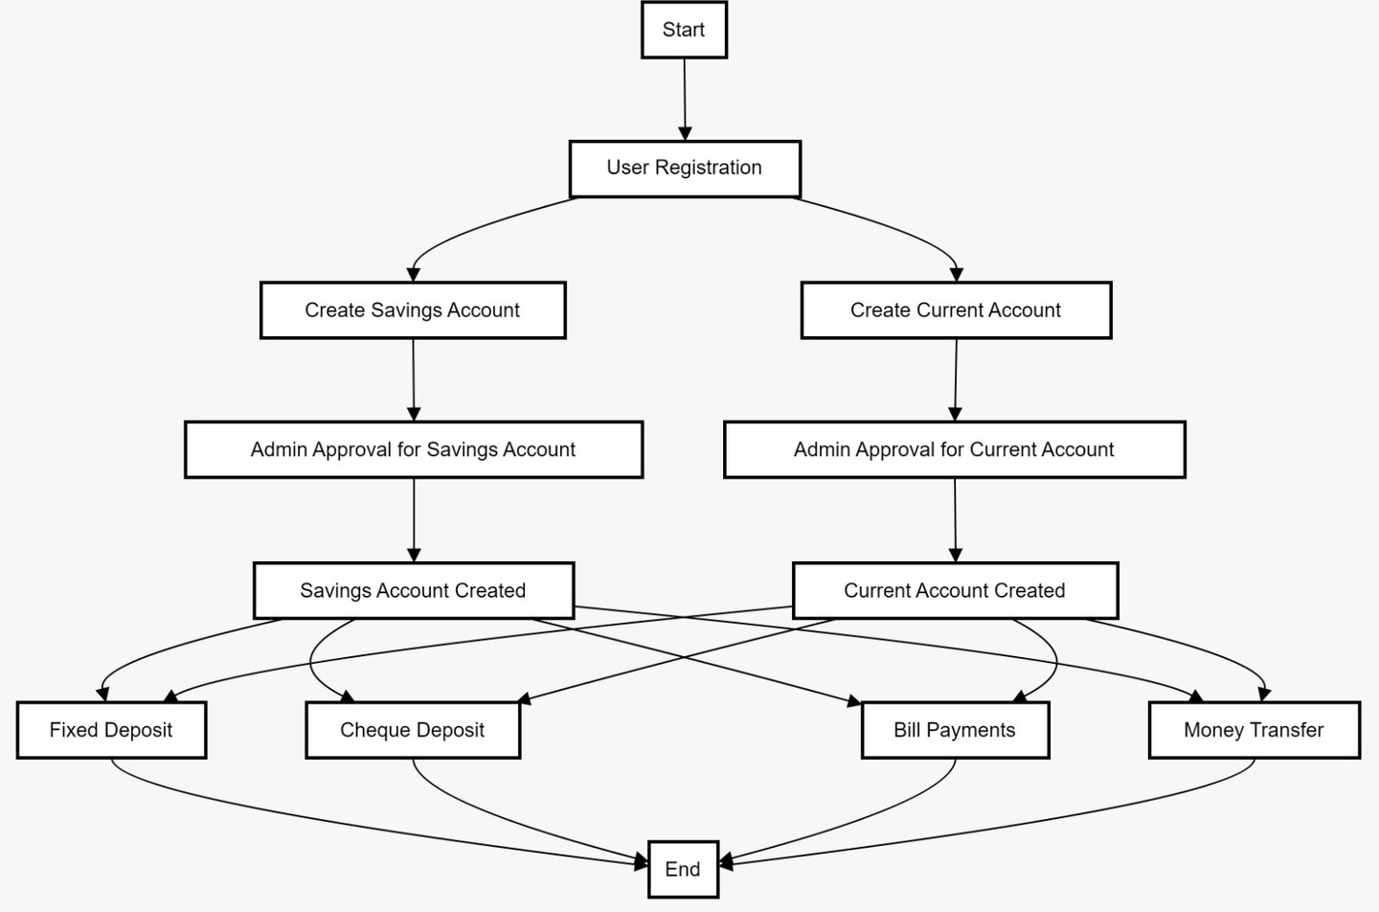
FLOW CHART

Slide 6
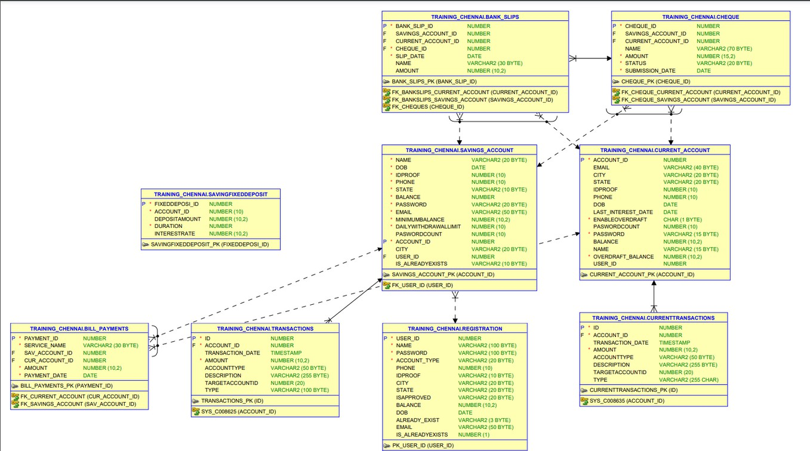
UML DIAGRAM

Slide 7
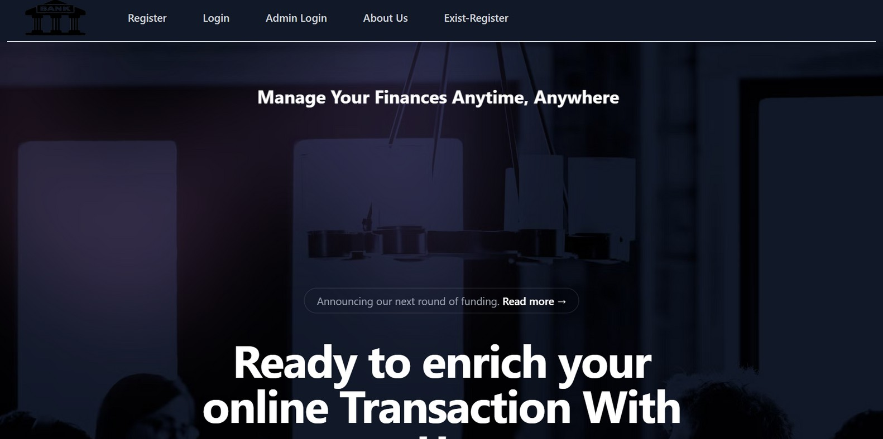
INB PORTAL (HOME PAGE)

Slide 8
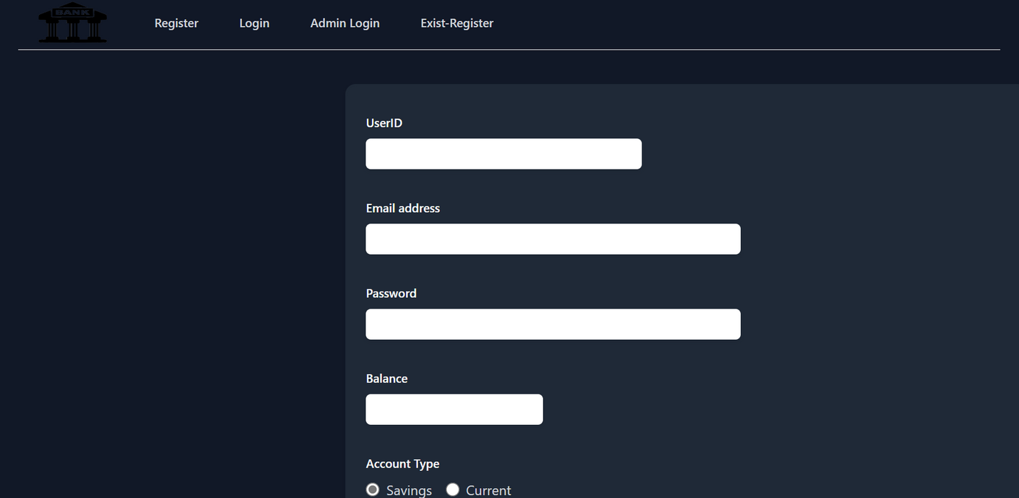
REGISTRATION PAGE

Slide 9
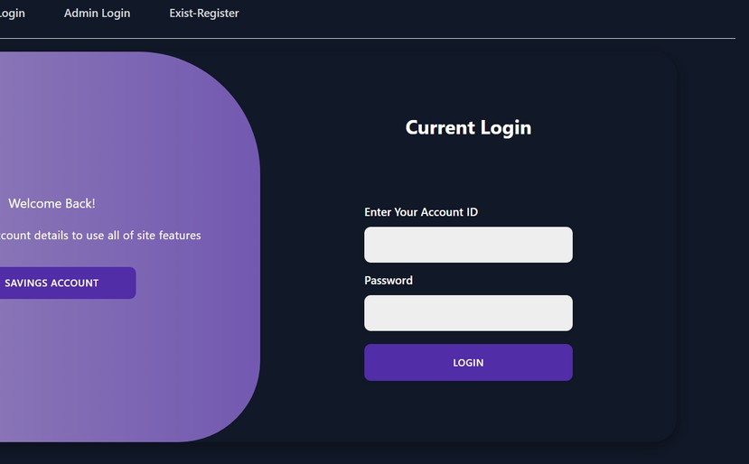
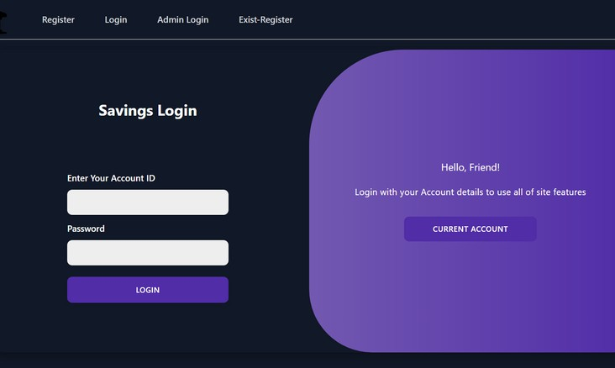
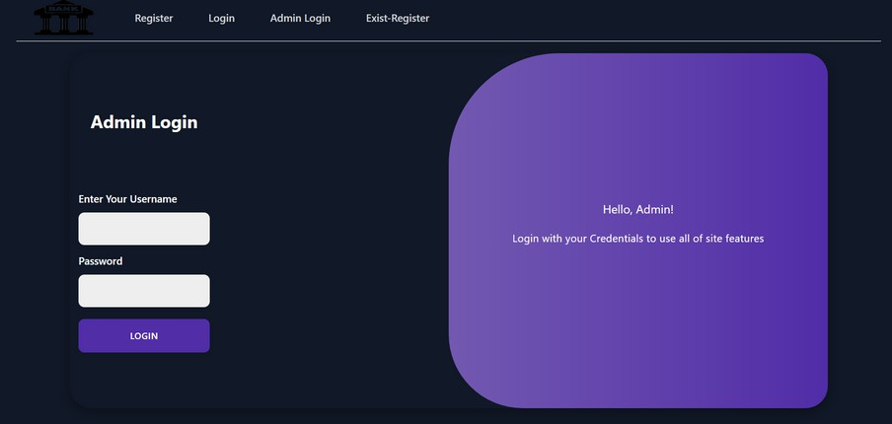
LOGIN PAGE

Slide 10
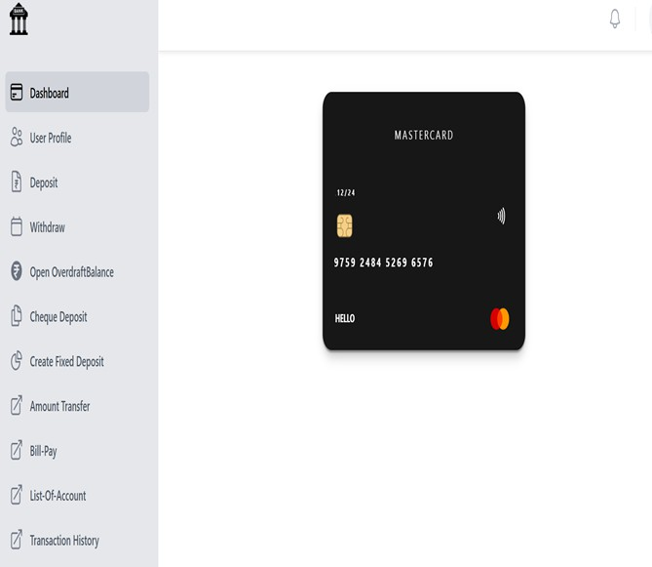
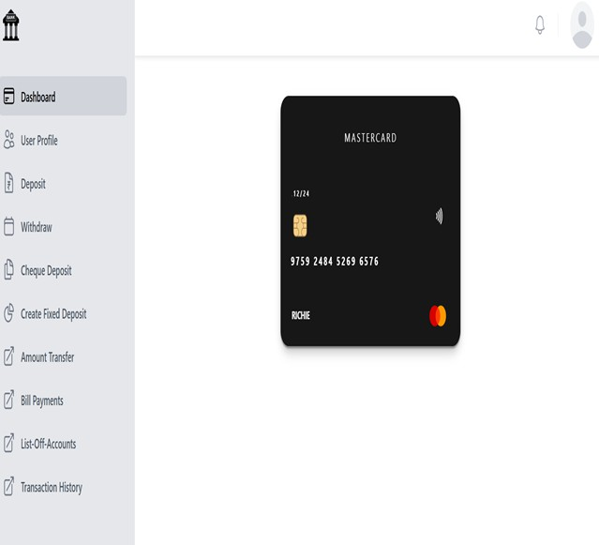
DASHBOARD

Slide 11
CONCLUSION
The Internet Banking platform, built with React and Tailwind on the front end, Java Spring Boot on the backend, and Oracle SQL for the database, delivers a secure and user-centric interface for seamless online banking. This platform elevates the user experience by offering real-time transaction monitoring, robust account management, and an extensive array of banking services. It empowers customers to manage their finances efficiently and securely from any location.

Slide 12
ACKNOWLEDGEMENT
We sincerely appreciate Mr. Sanjit for his invaluable guidance, encouragement, and dedicated supervision throughout this project. His expertise and support were crucial to our success. We are deeply grateful for his mentorship and intellectual insights.

Slide 13


